Slide 1



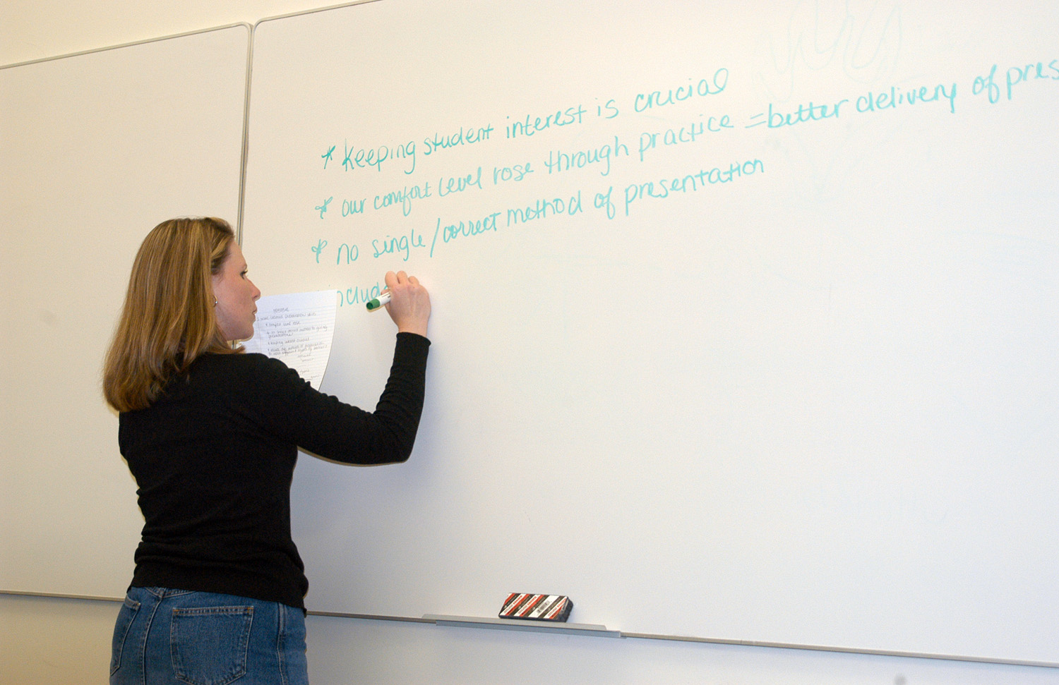
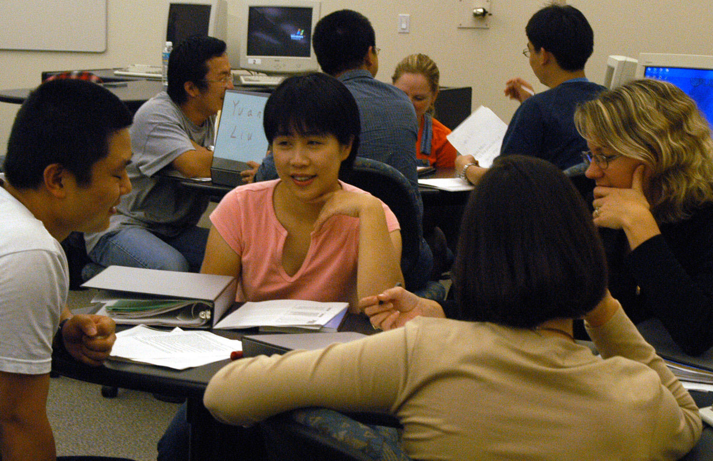
Knowledge Base
101 Classroom Assessment Techniques
Kevin Yee
Faculty Center for Teaching & Learning
University of Central Florida
Regardless of class size, engagement rises as interactivity increases. Assessment within the classroom provides the dual benefit of directly gauging student learning while raising the level of interaction and engagement.
Fifty Classroom Assessment Techniques (CATs) were outlined by Angelo/Cross (Classroom Assessment Techniques, Jossey-Bass, 1993). Several CATs can also be found in Teaching Creatively: Ideas in Action (Morrison-Shetlar, Marwitz, Outernet, 2001).
Future Research Ideas
1. Background Knowledge Probe
Focused Listing
Misconception Check
4. Empty Outlines
5. Memory Matrix
6. One-Minute Papers
7. Muddiest Point
8. Categorizing Grid
9. Defining Features Matrix
10. Pro and Con Grid
11. What/How/Why Outlines
12. Analytic Memo
13. One-Sentence Summary
14. Word Journal
15. Approximate Analogies
16. Concept Mapping
17. Invented Dialogues
18. Annotated Portfolios
19. Problem Recognition Tasks
20. What’s the Principle
21. Documented Problem Solutions
22. Audio and Videotaped Protocols
23. Directed Paraphrasing
24. Applications Cards
25. Student-Generated Test Questions
26. Human Tableau or Class Modeling
27. Paper or Project Prospectus
28. Classroom Opinion Polls
29. Double-Entry Journals
30. Profiles of Admirable Individuals
31. Everyday Ethical Dilemmas
32. Course-Related Self-Confidence Surveys
33. Focused Autobiographical Sketches
34. Interest/Knowledge/Skills Checklist
35. Goal Ranking and Matching
36. Self-Assessment of Ways of Learning
37. Productive Study-Time Logs
38. Punctuated Lectures
39. Process Analysis
40. Diagnostic Learning Logs
41. Chain Notes
42. E-Mail Feedback
43. Teacher-Designed Feedback Forms
44. Group Instructional Feedback Technique
45. Classroom Assessment Quality Circles
46. Recall, Summarize, Question, Connect, and
Comment
47. Group-Work Evaluations
48. Reading Rating Sheets
49. Assignment Assessments
50. Exam Evaluations
51. Drawing for Understanding
52. Impromptu Speeches
53. Pass the Chalk
54. Using Pictures
55. Student Pictures
56. Fishbowl
57. Application to Major
58. Haiku
59. Instructor Storytelling
60. Student Storytelling
61. Choral Response
62. Total Physical Response (TPR)
63. Think-Pair-Share
64. Jigsaw (Group Experts)
65. Forced Debate
66. Role-Playing
67. Definitions and Applications
68. Quaker Meeting
69. Line Dance
70. Four Corners
71. Simulation
72. Think Break
73. Optimist/Pessimist
74. Pop Culture
75. Opposites
76. Ranking Alternatives
77. Imaginary Show and Tell
78. Writing Fables
79. Movie Application
80. Pictionary
81. Super-Password
82. Find the Company
83. My Christmas Gift
84. Six Degrees of “RNA Transcription Errors”
85. Word of the Day
86. Questions as Homework
87. Group-Decided Question
88. Press Conference
89. Truth Statements
90. Brainstorming on the Board
91. All-day Chats
92. Quick Chat
93. Quick Evaluation
94. Objective Check
95. Peer Review Writing Task
96. Psychoanalysis
97. PowerPoint Presentations
98. Bridge Conference
99. Pre-Class Writing
100. Advice Letter
101. “Real-World”
Questions using these CATs in SoTL-type projects:
Can simulation and role-playing be used successfully in a large-class setting to increase engagement?
What benefits are derived from increasing perceived relevance to undergraduates, particularly in the use of CAT #74 (Pop Culture) and #101 (Real World)?
How much does student retention increase when writing CATs such as #78 (Writing Fables) and #14 (Word Journals)?
Does student performance increase when visual CATs are utilized more liberally, such as #55 (Student Pictures), and #51 (Drawing for Understanding)?
How do very large lecture classes benefit from inclusive activities like #58 (Haiku) and #6 (One-Minute Papers)?
Can groupwork be effectively introduced in very large lecture halls, particularly using #63 (Think-Pair-Share)?
Transferability
Most of the 101 CATs can be used in any discipline, and in any size class (with some adjustment needed for very large or very small classes). Commonly used CATs that are not discipline-specific:
One-Minute Paper: Students write for one minute on a specific question (which might be generalized to “what was the most important thing you learned today”). Best used at the end of the class session.
Think-Pair-Share: Students share and compare possible answers to a question with a partner before addressing the larger class.
Concept Mapping: Students write keywords onto sticky notes and then organize them into a flowchart. Could be less structured: students simply draw the connections they make between concepts.
Drawing for Understanding: Students illustrate an abstract concept or idea. Comparing drawings around the room can clear up misconceptions.
Jigsaw: Give each group a different topic. Re-mix groups with one planted “expert” on each topic, who now has to teach his new group.

