Slide 1

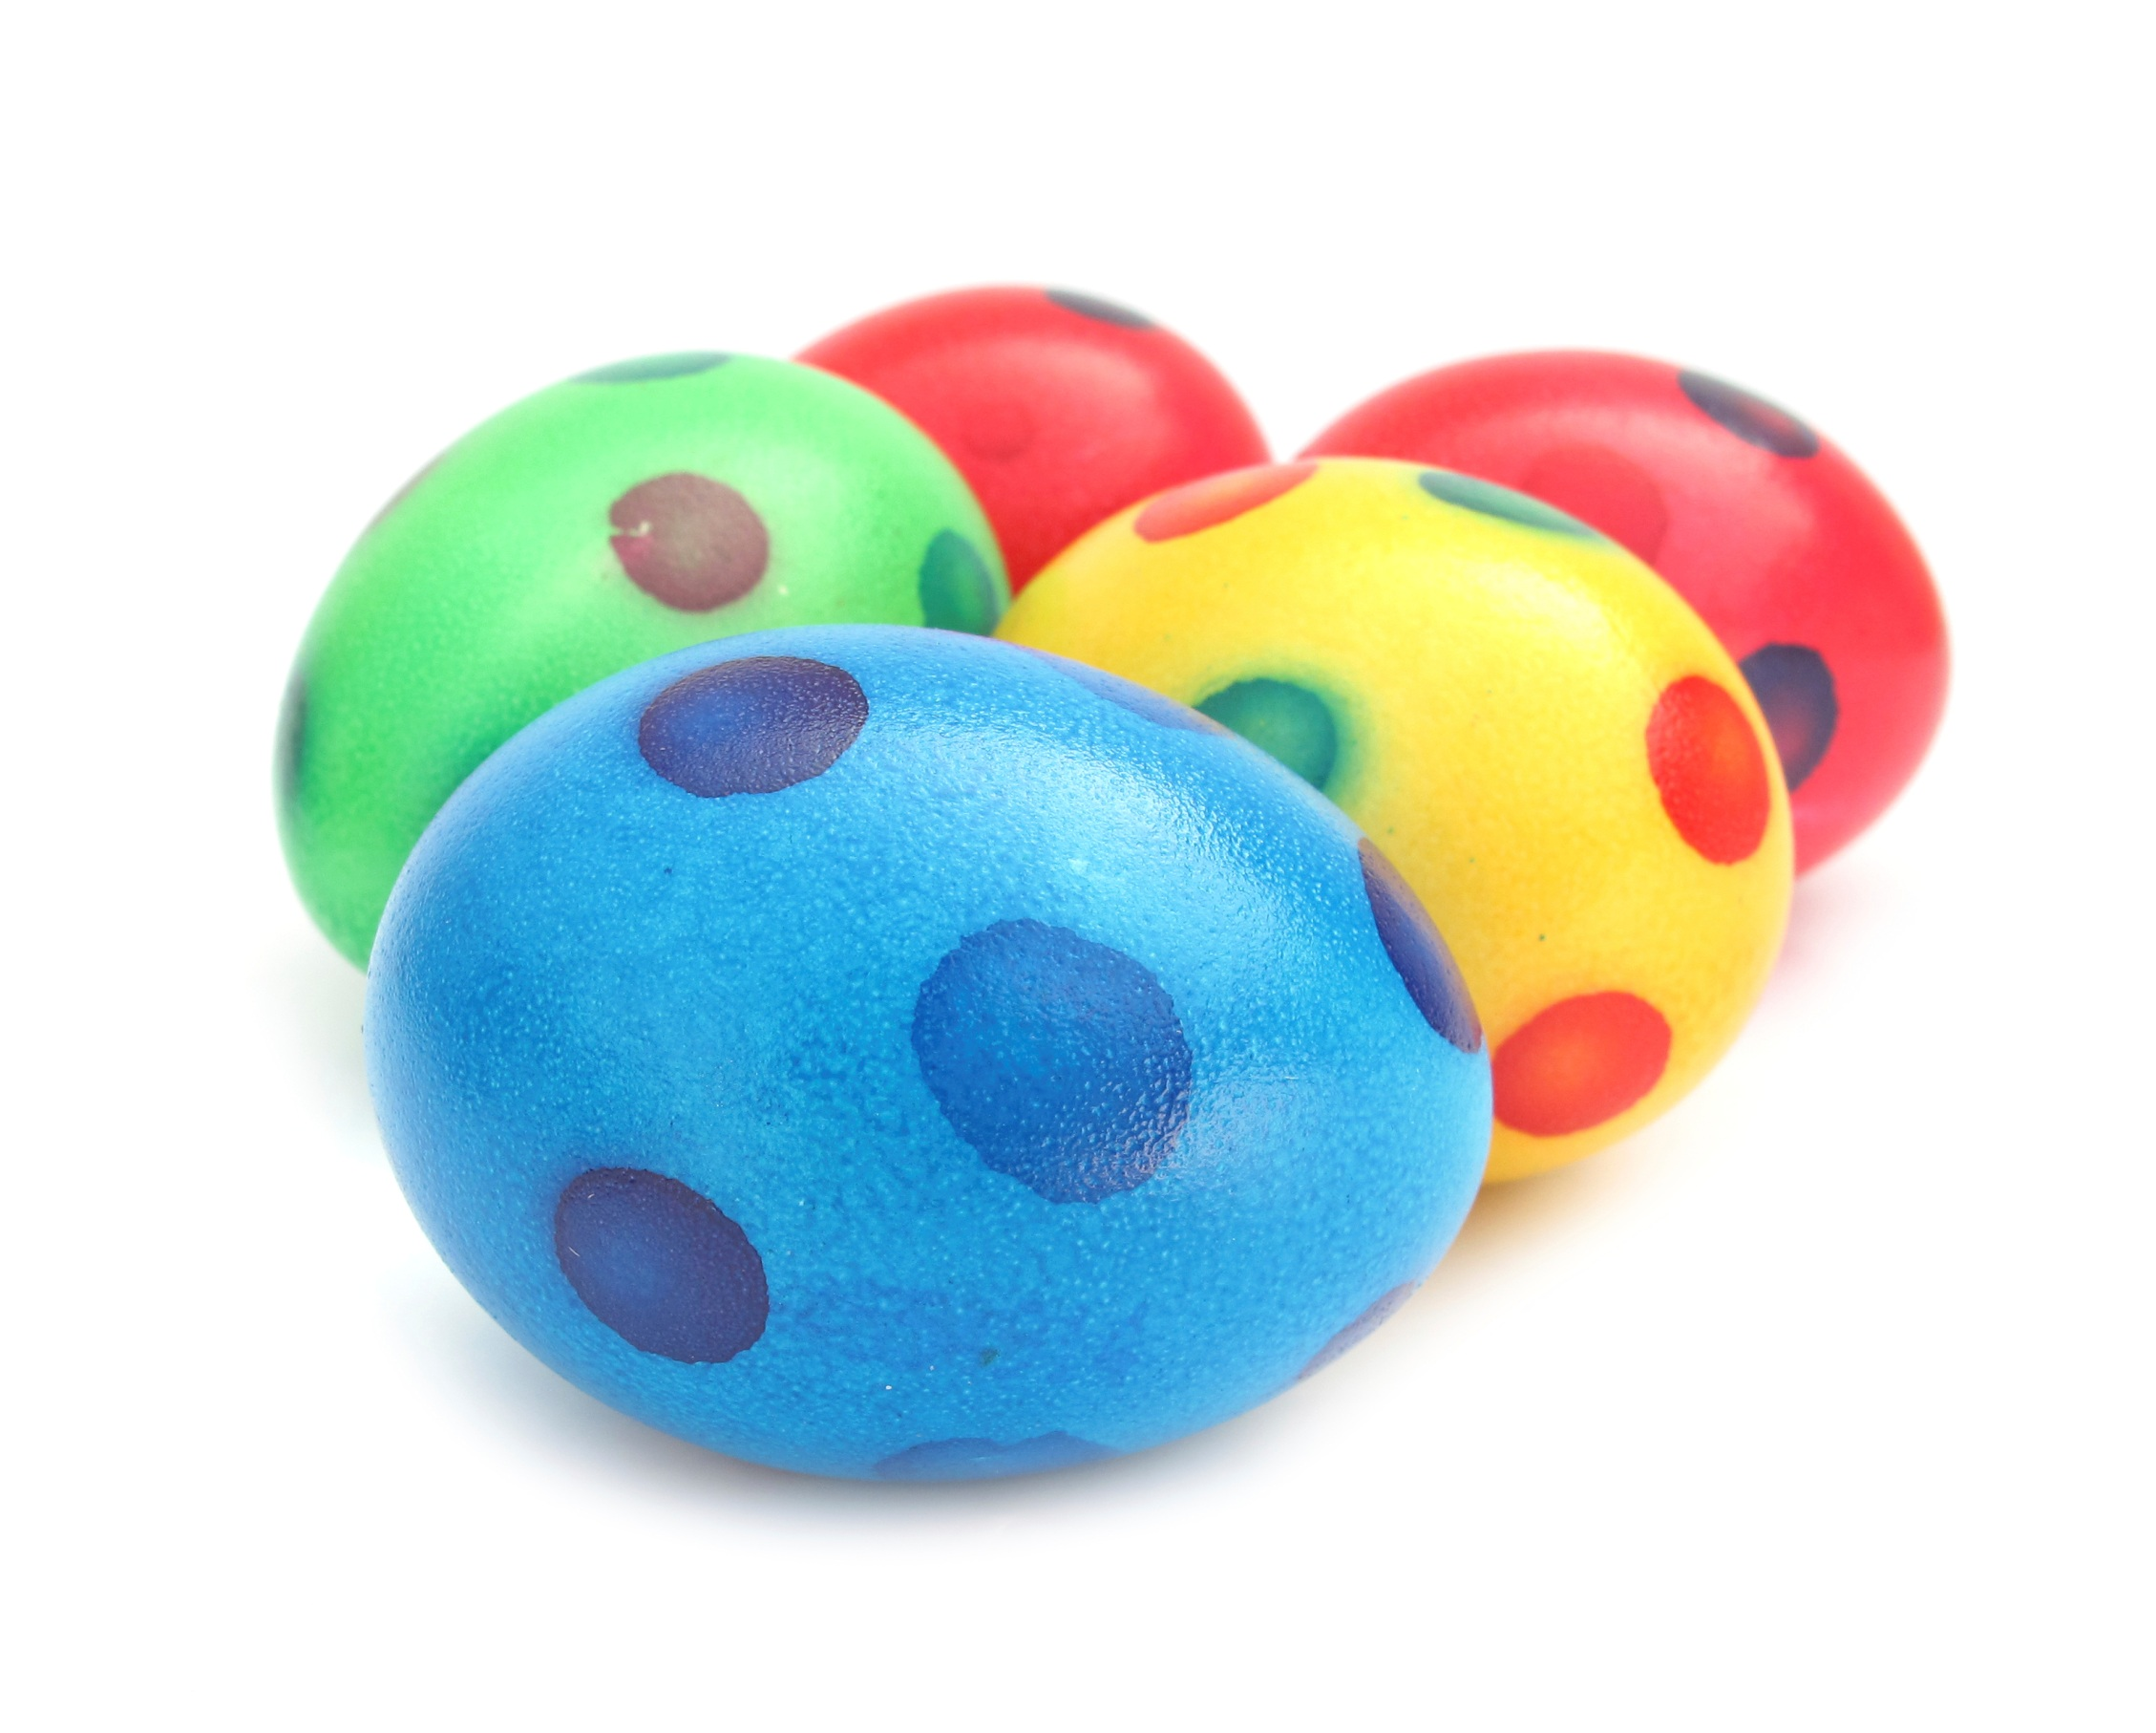

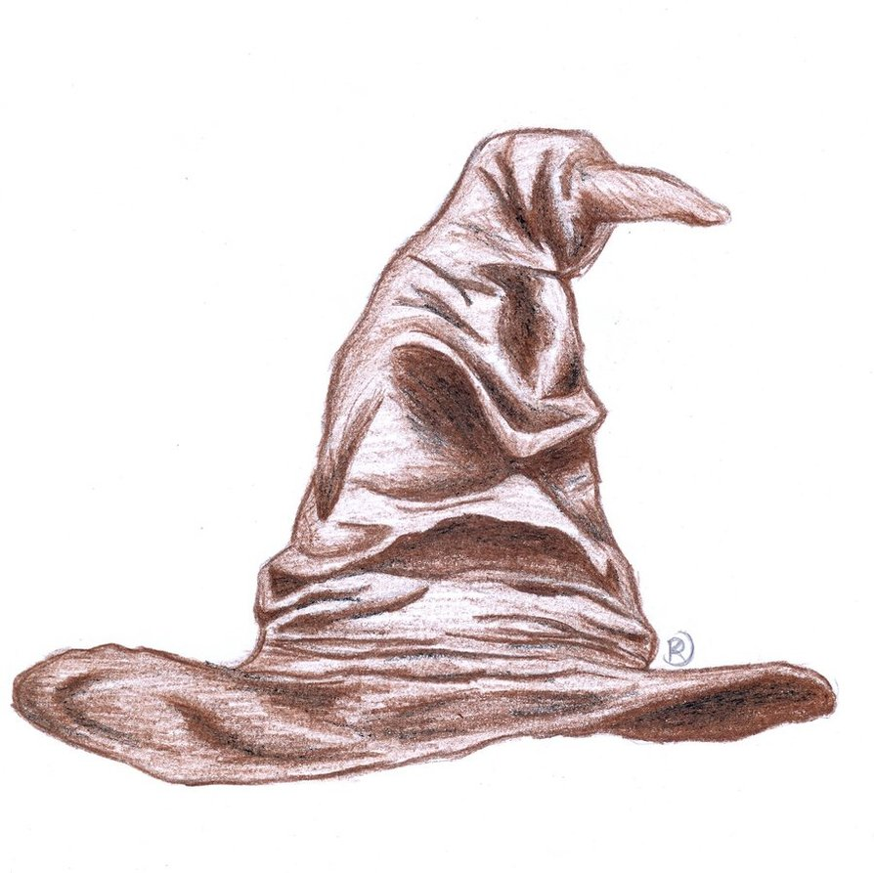

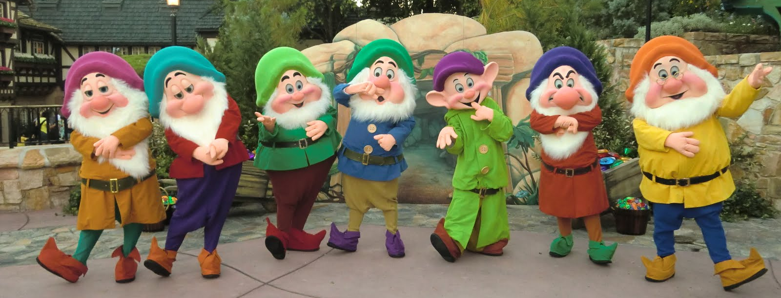
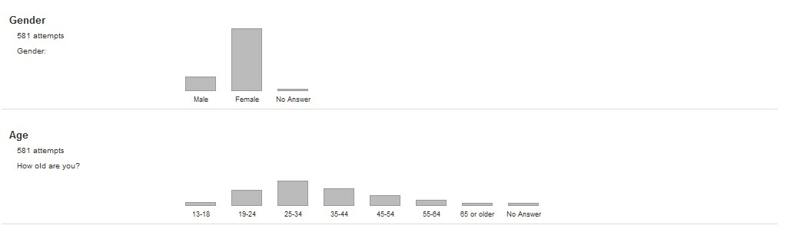

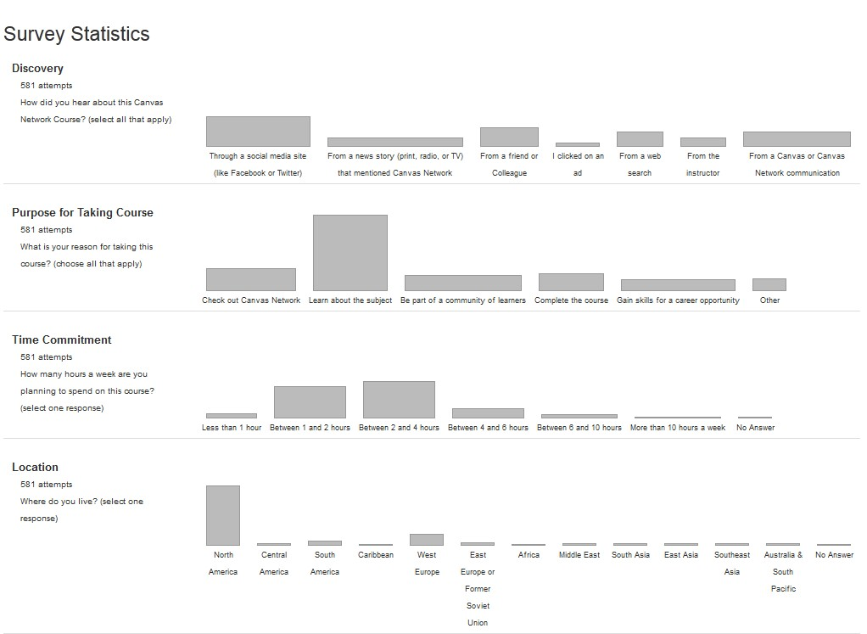
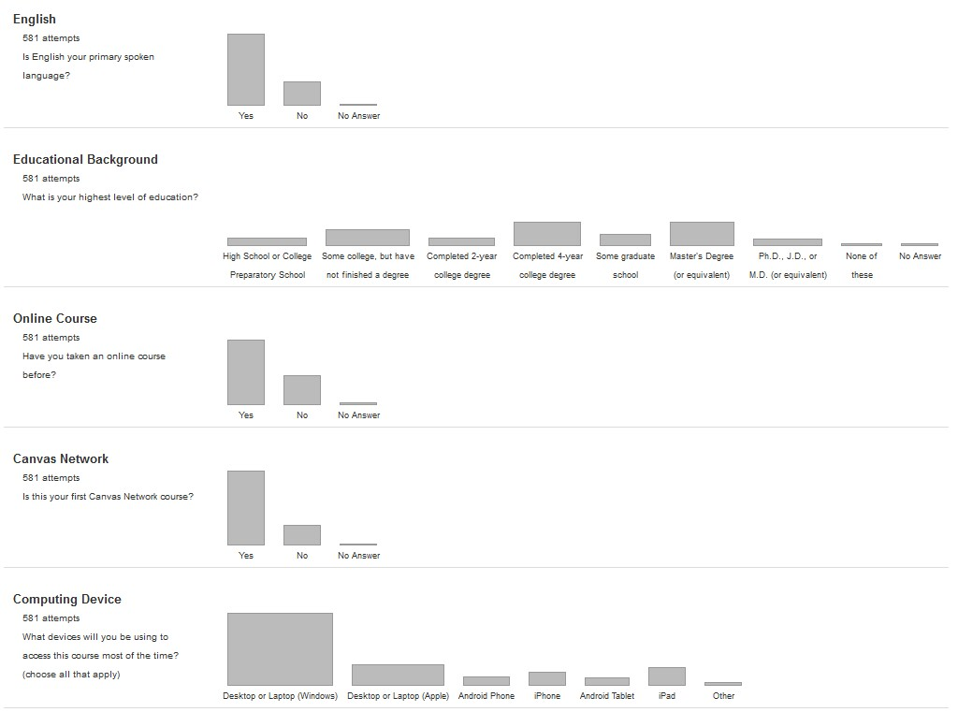
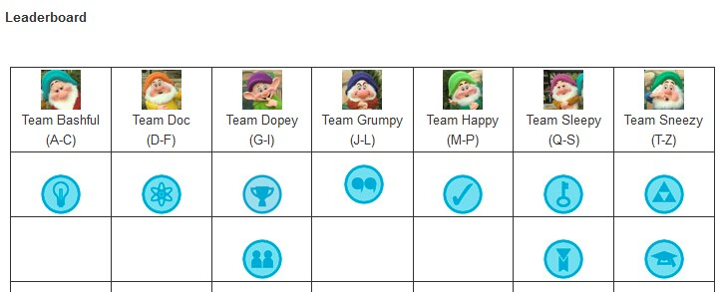
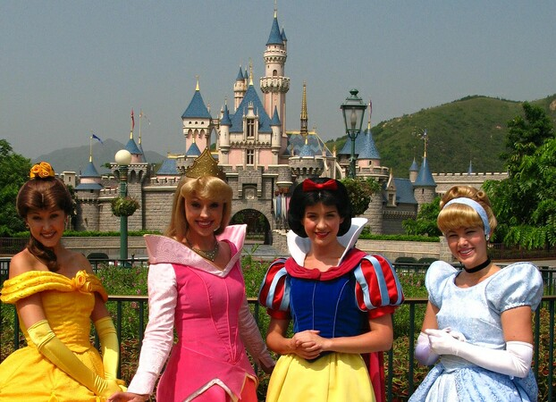




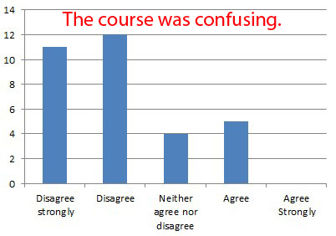
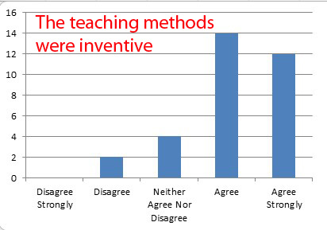




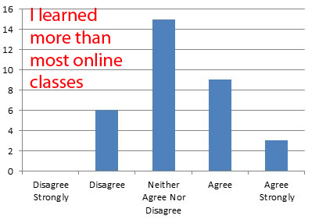
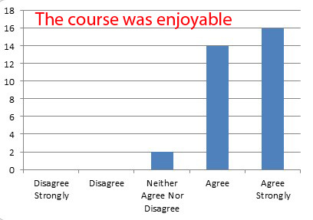

Gamification in a MOOC
Kevin Yee
Principles of Gamification
The House Challenge
Problem: Scale
Solution: Badges awarded to TEAMS (but based on individual effort)
Display Progress
Maximize Competition
Calibrate Difficulty Carefully
Provide Diversions
Employ Narrative Elements
MOOC Participants
Registrations: 1,391
Completed first module: 359 (25%)
Completed course: 65 (5%)
Completed first survey: 581
A Badge Too Far
MOOC: Fairy Tales
Meaning of princess stories
Literature studies, cultural studies, film studies
Completion Survey Results
Responses: 36
Sex: Male: 6, Female: 30
English as 1st Language: 22
Age: 0-17 (1), 18-22 (1), 23- 29 (10), 30-39 (10), 40- 49 (6), 50+ (6)
Race:
58% Caucasian,
19% Hispanic/Latino,
23% all others
Interpretive lenses: historical, authorial, feminist, queer, Biblical, Marxist, Freudian, Maslowian, Skinnerian

